Slide 1
Overview of Course
1. Introduction
2. Linear Regression and Decision Trees
3. Instance based learning Feature Selection
4. Probability and Bayes Learning
5. Support Vector Machines
6. Neural Network
7. Introduction to Computational Learning Theory
8. Clustering

Slide 2
UNIT-1: Overview of Course
Introduction to Machine Learning. Human Learning and its types.
Machine Learning and its types( Supervised, Unsupervised and Reinforcement Learning).
Well posted learning problems.
Applications of Machine Learning. Issues in Machine Learning
Basic Types of Data in Machine Learning: Numerical and Categorical data, Data Quality and Remediation.

Slide 3
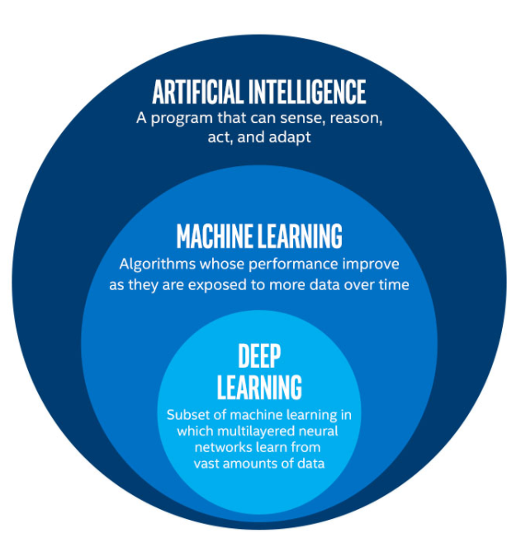
Figure1:- Machine

Slide 4
Artificial Intelligence is the concept of creating smart intelligent machines. Ability of machine to imitate intelligence like Intelligent human brain.
Machine Learning is a subset of artificial intelligence that helps you build AI-driven applications. It is the application of AI that allows system to automatically learn and improve from experience.
Deep Learning is a subset of Machine Learning that uses complex algorithms and deep neural network to train a model.

Slide 5
Difference Between Machine Learning And Artificial Intelligence
Artificial Intelligence is a concept of creating intelligent machines that stimulates human behaviour whereas
Machine learning is a subset of Artificial intelligence that allows machine to learn from data without being programmed.

Slide 6
Ever since computers were invented, we have wondered whether they might be made to learn. If we could understand how to program them to learn-to improve automatically with experience-the impact would be dramatic.
Imagine computers learning from medical records which treatments are most effective for new diseases.
A successful understanding of how to make computers learn would open up new uses of computers and new levels of competence and customization.

Slide 7
We do not know yet, how to make computers learn nearly as well as people learn.
However, algorithms have been invented that are effective for certain types of learning tasks, and a theoretical understanding of learning is beginning to emerge.
Many practical computer programs have been developed to exhibit useful types of learning, and significant commercial applications have begun to appear.
For problems such as speech recognition, algorithms based on machine learning perform all other approaches that have been attempted to date.
In the field known as data mining, machine learning algorithms are being used routinely to discover valuable knowledge from large commercial databases containing equipment maintenance records, loan applications, financial transactions, medical records, patient record etc.

Slide 8
A few specific achievements provide a glimpse of the state of the art:
Programs have been developed that successfully learn to recognize spoken words.
Predict recovery rates of pneumonia patients, detect fraudulent use of credit cards, drive autonomous vehicles on public highways.
Play games such as backgammon at levels approaching the performance of human world champions

Slide 9
What is data science?
Data science is the field of applying advanced analytics techniques and scientific principles to extract valuable information from data for decision-making, strategic planning and other business uses.
Data science combines math and statistics, specialized programming, advanced analytics, artificial intelligence (AI), and machine learning to uncover actionable insights hidden in an organization’s data.
Data science is the study of data to extract meaningful insights for business.
It combines principles and practices from the fields of mathematics, statistics, artificial intelligence, and computer engineering to analyze large amounts of data.
These insights can be used to guide decision making and strategic planning.

Slide 10
Prerequisite for Data Science
1.Machine Learning:- Machine learning is the backbone of data science. Data Scientists need to have a solid grasp of ML in addition to basic knowledge of statistics.
2. Modeling:- Mathematical models enable you to make quick calculations and predictions based on what you already know about the data.
3. Statistics:- A sturdy handle on statistics can help you extract more intelligence and more meaningful results.
4. Programming:- The most common programming languages are Python, and R. Python is especially popular because it’s easy to learn, and it supports multiple libraries for data science and ML.
5. Databases:- A capable data scientist needs to understand how databases work, how to manage them, and how to extract data from them.

Slide 11
Different Roles/Jobs in Data Science
Data Scientist:
Data scientists require computer science and pure science skills beyond those of a typical business analyst or data analyst.
The data scientist must also understand the specifics of the business, such as Manufacturing, eCommerce, healthcare, Agriculture domain knowledge.
Job role: Determine what the problem is, what questions need answers, and where to find the data. Also, they mine, clean, and present the relevant data.
Skills needed: Programming skills (SAS, R, Python), storytelling and data visualization, statistical and mathematical skills, knowledge of Hadoop, SQL, and Machine Learning.

Slide 12
Data analyst:
Job role: Analysts bridge the gap between the data scientists and the business analysts, organizing and analyzing data to answer the questions. They take the technical analyses and turn them into qualitative action items.
Skills needed: Statistical and mathematical skills, programming skills (SAS, R, Python), plus experience in data wrangling and data visualization.
Data Engineer:
Job role: Data engineers focus on developing, deploying, managing, and optimizing the organization’s data infrastructure and data pipelines. Engineers support data scientists by helping to transfer and transform data for queries.
Skills needed: NoSQL databases (e.g., MongoDB, Cassandra DB), programming languages such as Java and Scala, and frameworks (Apache Hadoop).

Slide 13
Business Managers:
Their primary responsibility is to collaborate with the data science team to characterize the problem and establish an analytical method.
Their goal is to ensure projects that are completed on time by collaborating with data scientists and IT managers.
IT Managers:
They are primarily responsible for developing the infrastructure and architecture to enable data science activities.
Data science teams are constantly monitored and resourced accordingly to ensure that they operate efficiently and safely.
They also be in charge of creating and maintaining IT environments for data science teams.

Slide 14
Data Science tools
Data scientists rely on the following popular programming languages:
Open source tools support pre-built statistical modeling, machine learning, and graphics capabilities.
R Studio: An open source programming language and environment for developing statistical computing and graphics.
2. Python: It is a dynamic and flexible programming language. The Python includes numerous libraries, such as NumPy, Pandas, Matplotlib, for analyzing data quickly.

Slide 15
Data Science Tools
Data Analysis: SAS, Jupyter, R Studio, MATLAB, Excel, RapidMiner.
Data Warehousing: Informatica/ Talend, AWS Redshift
Data Visualization: Jupyter, Tableau, Cognos, RAW
Machine Learning: Spark MLib, Mahout, Azure ML studio

Slide 16
What is Machine Learning?
Learning:- Learning is any process by which a system improves performance from experience. - Herbert Simon.
Learning is the ability to improve one's behaviour based on experience.
Machine learning is a discipline of computer science that uses computer algorithms/techniques and analytics to build predictive models that can solve business problems.
Machine Learning explores algorithms that can
– learn from data / build a model from data
– use the model for prediction, decision making or solving some problem.
Learning is used when:
Human expertise does not exist (navigating on Mars),
Humans are unable to explain their expertise (speech recognition)
Solution changes in time (routing on a computer network)
Solution needs to be adapted to particular cases (user biometrics)
Definition by Tom Mitchell on machine learning:
“A computer program is said to learn from experience E with respect to some class of tasks T and performance measure P, if its performance at tasks T, as measured by P, improves with experience E.”

Slide 17
Components of a learning problem
• Task: The behaviour or task being improved.
– For example: classification, acting in an environment
• Data: The experiences that are being used to improve performance in the task.
• Measure of improvement :
– For example: increasing accuracy in prediction, acquiring new, improved speed and efficiency.

Slide 18
How Does Machine Learning Work?
Machine learning accesses vast amounts of data (both structured and unstructured) and learns from it to predict the future.
It learns from the data by using multiple algorithms and techniques.
Below is a diagram that shows how a machine learns from data.
https://www.simplilearn.com/tutorials/artificial-intelligence-tutorial/ai-vs-machine-learning-vs-deep-learning
Reference Books:
1. Machine-Learning-Tom-Mitchell Publisher: McGraw-Hill
2. Introduction to Machine Learning-The MIT Press (2014)
Machine Learning
Algorithm
Past Data
Output

Slide 19
Programs vs learning algorithms
Algorithmic solution
Data
Computer
Output
Program
Machine Learning solution
Data
Computer
Program
Output

Slide 20
Domains and ML Applications
Domain:- Automobile
Example: A robot driving learning problem
Task T: driving on public four-lane highways using vision sensors
Performance measure P: average distance traveled before an error.
Training experience E: a sequence of images and steering commands recorded while observing a human driver.

Slide 21
Domain: Health Care
• Task T: Diagnose a disease
– Input: symptoms, lab measurements, test result.
– Output: One of set of possible diseases, or
“none of the above”
• Data: Historical medical records.
• Learn: which future patients will respond best to which treatments

Slide 22
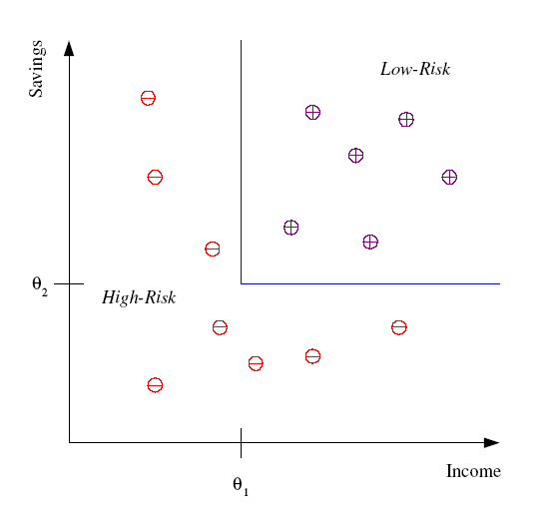
Classification
Example: Credit scoring
Differentiating between low-risk and high-risk customers from their income and savings
Discriminant: IF income > θ₁ AND savings > θ₂
THEN low-risk ELSE high-risk

Slide 23








Face Recognition
Training examples of a person
Test images
AT&T Laboratories, Cambridge UK
http://www.uk.research.att.com/facedatabase.html

Slide 24
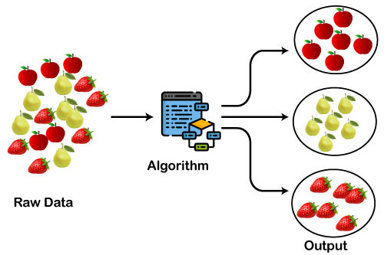
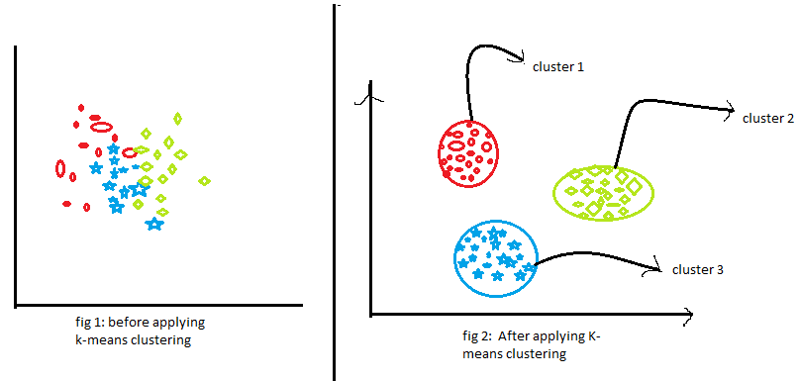
Clustering

Slide 25
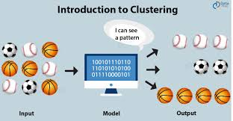
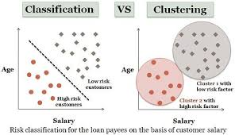
Clustering

Slide 26
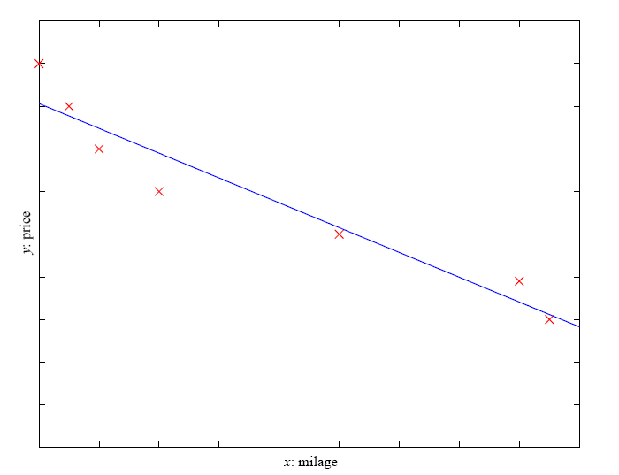
Regression
Example: Price of a used car
x : car attributes
y : price
y = g (x | θ )
g ( ) model,
θ parameters
y = wx+w₀

Slide 27
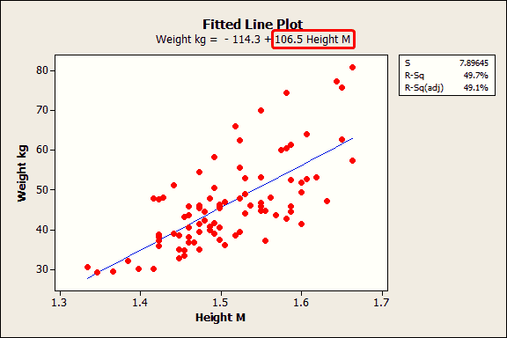
Regression:

Slide 28
Some other applications
• Fraud detection : Credit card Providers
Determine whether or not someone will default on a home mortgage.
Understand consumer sentiment based off of unstructured text data.
Determine customers behavior based on previous records/pattern.

Slide 29
Speech recognition:
Face Recognition:
Weather Forecasting
NLP:
detect where entities are mentioned in NL
detect what facts are expressed in NL
detect if a product/movie review is positive, negative, or neutral
Financial:
Predict if a stock will rise or fall?
Predict if a user will click on an ad or not?

